Slide 1
Convolutional Neural Networks(CNNs)
Jovan L. Thompson
May 29, 2024

Slide 2
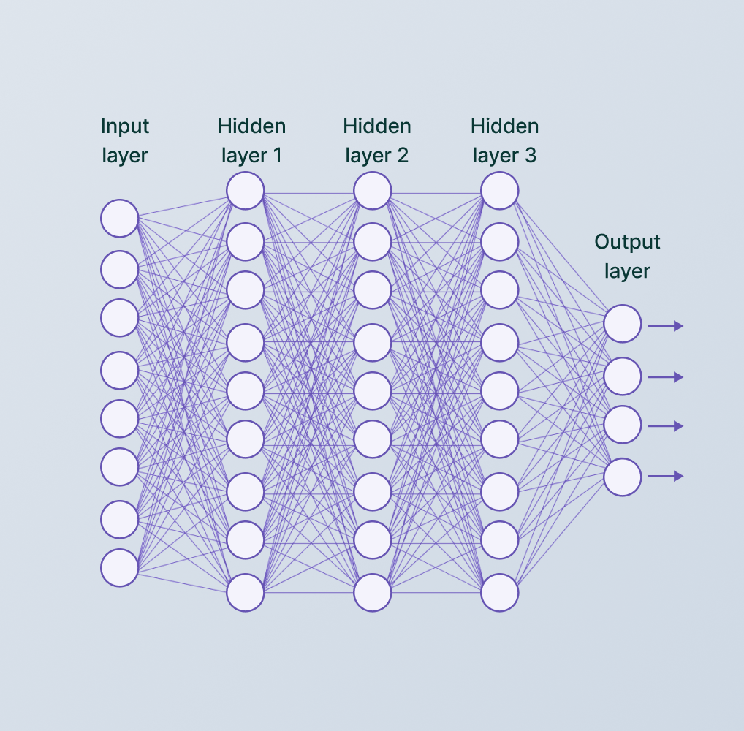
Table of contents
Introduction to Convolutional Neural Networks (CNNs)
Core Concepts of CNNs
Security Concerns with CNNs
Ethical Implications of CNNs: A Christian Perspective
Conclusions
References
¹ Baheti, P. (2021, June 27). A comprehensive guide to convolutional neural networks. .

Slide 3



Introduction to Convolutional Neural Networks (CNNs)
What are CNNs?
Why are CNNs Important?
How are CNN’s Used?​
Specialized neural networks designed for processing grid-like data (images & adapted for time-series data for local patterns & time dependencies).
Mimic the human visual cortex to learn patterns and features from data.
Utilizes layers of neurons arranged in a three-dimensional structure. Neurons are the size of the featue map x filters or pooling reduction.
Revolutionized computer vision and image recognition tasks.; k-NN and SVM used prior to CNNs.
Achieved state-of-the-art performance in various domains.
Enhances accuracy and efficiency in tasks involving large-scale image data.
Facilitates advancements in automation and machine learning applications.
Facial recognition (security, authentication).
Self-driving cars (object detection, lane tracking).
Medical imaging (diagnosis, disease detection).
Handwriting recognition (document analysis, automation).
Wildlife monitoring (species identification).
Agricultural tech (crop health monitoring).

Slide 4




Core Concepts of CNNs
Convolutional Layers
Pooling Layers
Types of Dataset
Widely Used Libraries
Apply filters to detect and extract features like edges, shapes, and textures.
Multiple layers learning increasingly complex features is an effective approach.
Reduce the dimensionality of feature maps.
Helps the network focus on essential information.
Gives translation invariance.
Common types: max, average, global, & stochastic
Fashion-MNIST: Dataset of Zalando's article images for benchmarking machine learning algorithms.
MNIST: Handwritten digit dataset for classification.
CIFAR-10/100: Smaller datasets for varied object class & subclass recognition.
Kaggle: Shoe vs Sandal vs Boot Image Dataset
TensorFlow: Deep learning framework by Google.
Keras: User-friendly API built on top of TensorFlow.
PyTorch: Flexible research-oriented deep learning framework by Facebook.
OpenCV: Library for real-time computer vision applications.
Scikit-learn: Efficient tools for data mining, analysis, and machine learning tasks.
NumPy: For computing arrays
² Saha, S. (2018, December 15). A comprehensive guide to convolutional neural networks

Slide 5
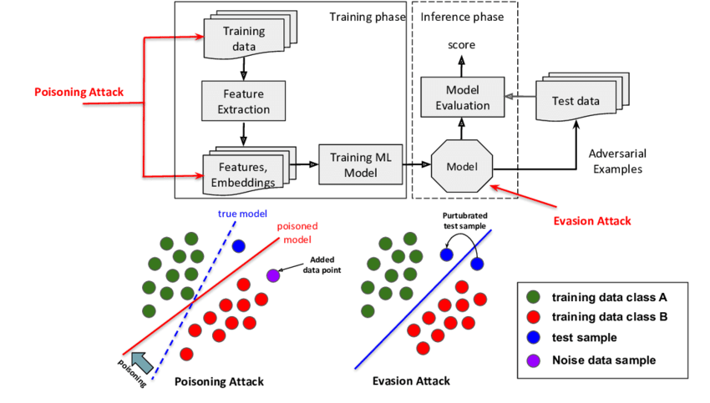
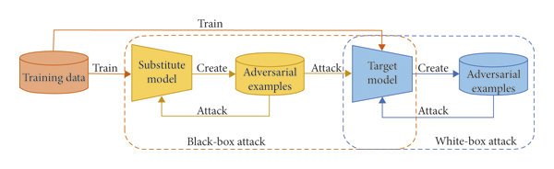
Security Concerns with CNNs
Adversarial Attacks
Model Poisoning
Subtle perturbations to input data that can confuse CNNs.
Types:
Black-box (attacker only knows model output).
White-box (attacker knows model internals)
Consequences: Misclassification, security breaches, safety risks.
Malicious actors manipulate training data to compromise the model.
Methods: Insertion of poisoned data during training, altering model parameters.
Consequences: Biased predictions, incorrect classifications, compromised system integrity.
Gupta, S. (2023, August 11). Model Poisoning: Threat and Implications for Fraud and Credit Risk
Luo, Y., Ye, F., Weng, B., Du, S., & Huang, T. (2021). A novel defensive strategy for facial manipulation detection combining bilateral filtering and joint adversarial training
Figure 2: e overall framework of the adversarial attacks. e white-box attack process is shown in the blue dotted box, and the black-box attack process is shown in the yellow dotted box.

Slide 6
Ethical Implications of CNNs: A Christian Perspective
Privacy Concerns
Bias and Discrimination
Stewardship of Technology
Facial recognition and surveillance can violate personal privacy.
Example: Unauthorized use of facial recognition in public spaces.
Potential for misuse and abuse of sensitive data.
Conflict with the Christian principle of respecting human dignity and autonomy.
CNNs can inherit biases from training data, leading to discriminatory outcomes.
Examples: Facial recognition systems performing poorly on darker skin tones.
Example: Biased hiring algorithms that disadvantage certain demographic groups.
Violates the Christian principle of loving one's neighbor as oneself and treating all people with justice and fairness.
Responsibility to use AI for good and avoid harm.
Encourages the development of transparent and accountable AI systems.
Alignment with the Christian worldview of using
God's gifts for the benefit of humanity.

Slide 7
Conclusions
Introduction to Convolutional Neural Networks (CNNs):
CNNs are specialized neural networks for processing grid-like data like images and time-series data, mimicking the human visual cortex. They revolutionized computer vision, achieving state-of-the-art performance in tasks involving large-scale image data, thus enhancing accuracy and efficiency.
Core Concepts of CNNs:
Key concepts include convolutional layers for feature extraction and pooling layers for dimensionality reduction. Popular datasets are Fashion-MNIST, MNIST, CIFAR-10/100, and custom Kaggle datasets. Widely used libraries like TensorFlow, Keras, PyTorch, OpenCV, and Scikit-learn support various deep learning tasks.
Security Concerns with CNNs:
CNNs face threats like adversarial attacks, which subtly alter input data, and model poisoning, where training data is manipulated. These issues can lead to misclassification and compromised system integrity, highlighting the need for robust security measures in CNN applications.
Ethical Implications of CNNs: A Christian Perspective:
Ethical issues include privacy violations and biases in CNNs, conflicting with Christian principles of dignity and fairness. Addressing these concerns is essential for responsible AI use, promoting transparent and fair technology that benefits humanity.

Slide 8
References
Baheti, P. (2021, June 27). A comprehensive guide to convolutional neural networks. Retrieved from https://www.v7labs.com/blog/convolutional-neural-networks-guide
Saha, S. (2018, December 15). A comprehensive guide to convolutional neural networks — the ELI5 way. Saturn Cloud. Retrieved from https://saturncloud.io/blog/a-comprehensive-guide-to-convolutional-neural-networks-the-eli5-way/
Luo, Y., Ye, F., Weng, B., Du, S., & Huang, T. (2021). A novel defensive strategy for facial manipulation detection combining bilateral filtering and joint adversarial training. ResearchGate, 2021(7), 1-10. Retrieved from https://www.researchgate.net/publication/353673913_A_Novel_Defensive_Strategy_for_Facial_Manipulation_Detection_Combining_Bilateral_Filtering_and_Joint_Adversarial_Training
Gupta, S. (2023, August 11). Model Poisoning: Threat and Implications for Fraud and Credit Risk. Retrieved from https://www.linkedin.com/pulse/model-poisoning-threat-implications-fraud-credit-risk-sharad-gupta/

